Slide 1
Team 7조: Daegu Marble
COMP217017 Java Programming (Spring’19)
Team members: 변주영, 정민욱

Slide 2
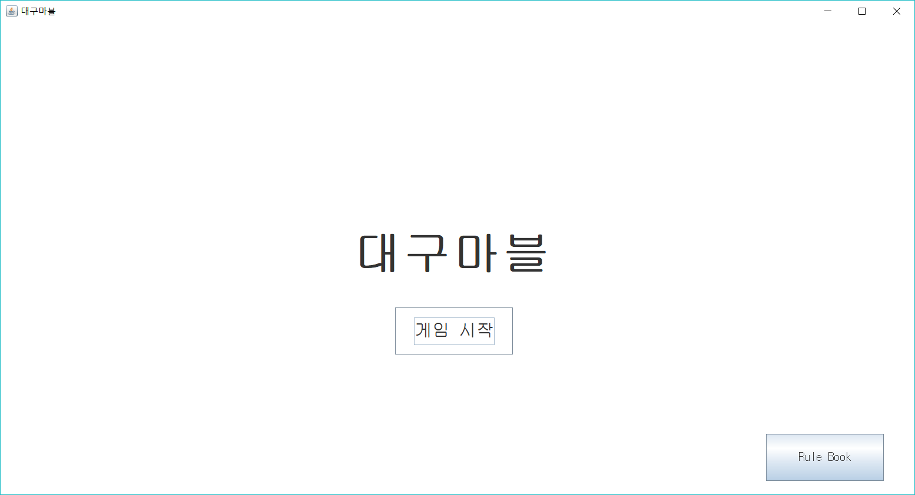
Overview of Project
Give what topic your project is concerned about.
Briefly explain your project.
Optionally, explain the features of your project.

Slide 3
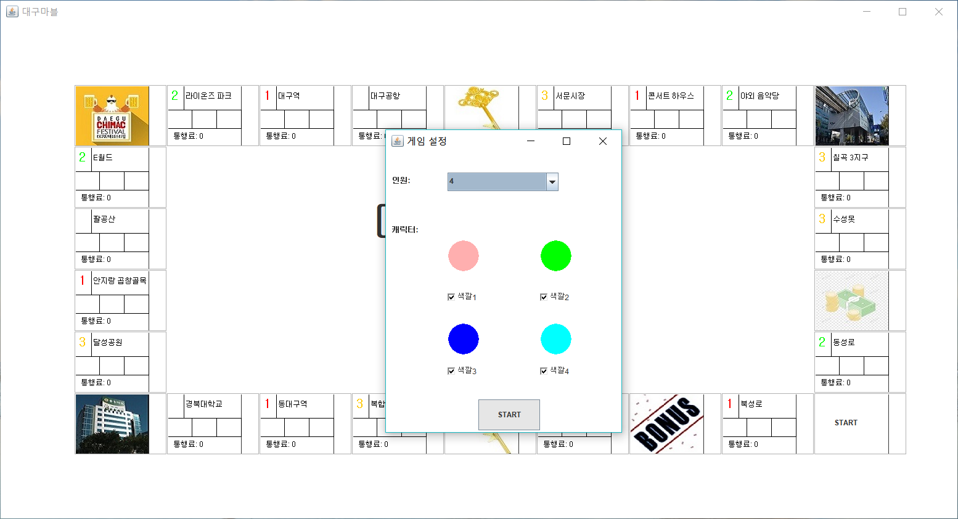
Overview of Project
Give what topic your project is concerned about.
Briefly explain your project.
Optionally, explain the features of your project.

Slide 4
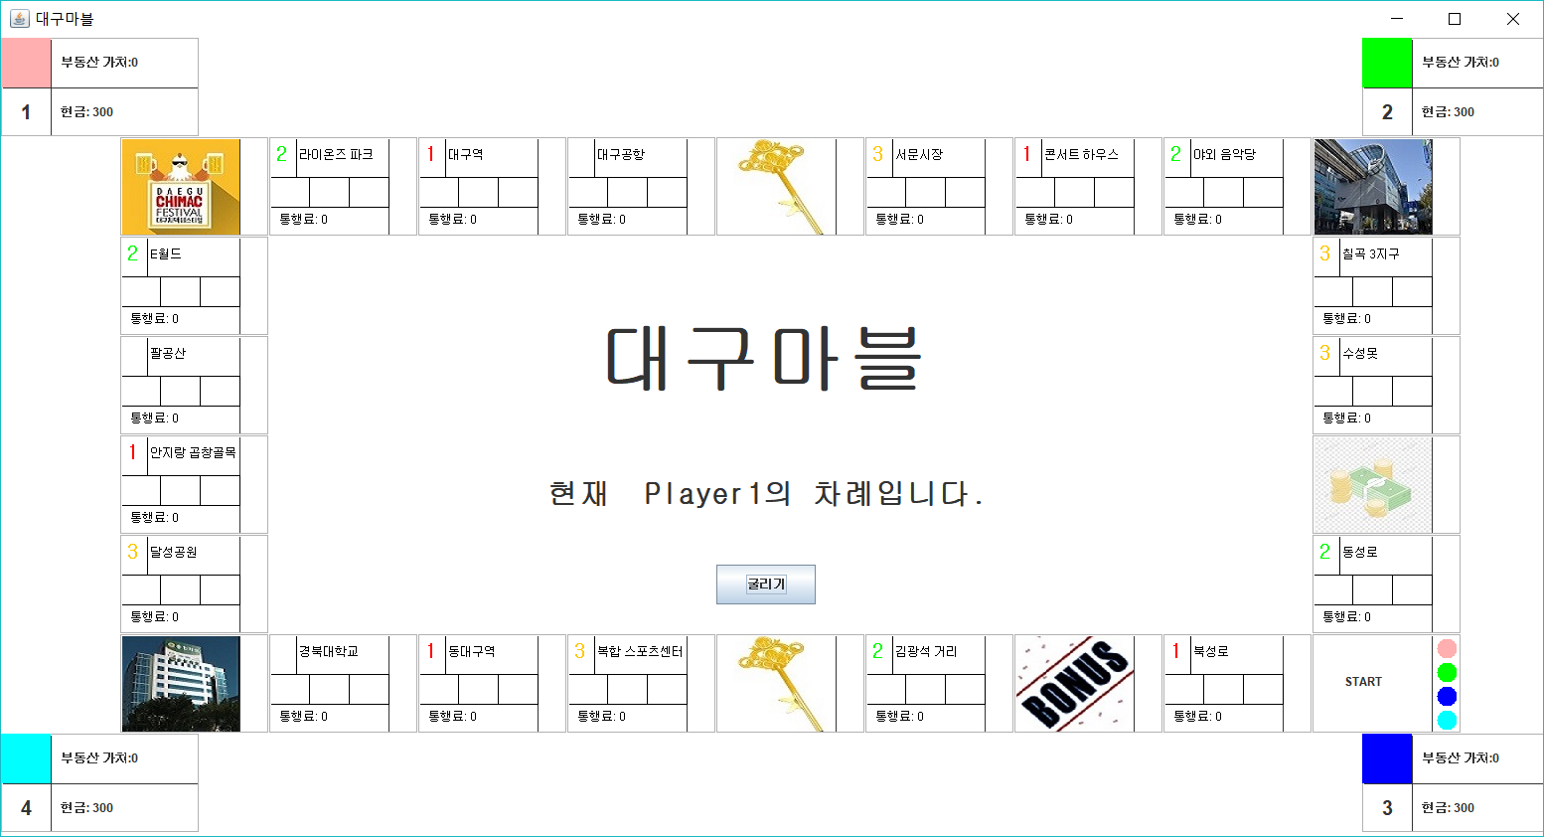
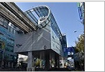

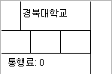
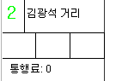

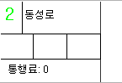
Overview of Project
Give what topic your project is concerned about.
Briefly explain your project.
Optionally, explain the features of your project.

Slide 5
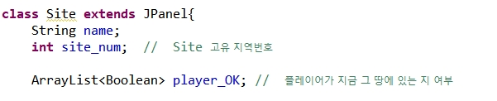
Detailed Project Description (1 / 5)

Slide 6
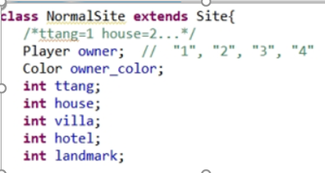
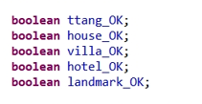
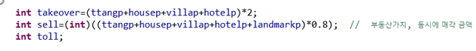
Detailed Project Description (3 / 5)

Slide 7
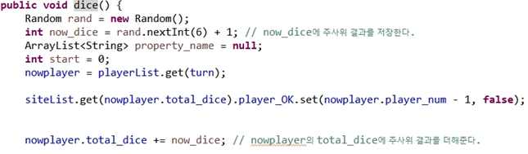
Detailed Project Description (4 / 5)

Slide 8
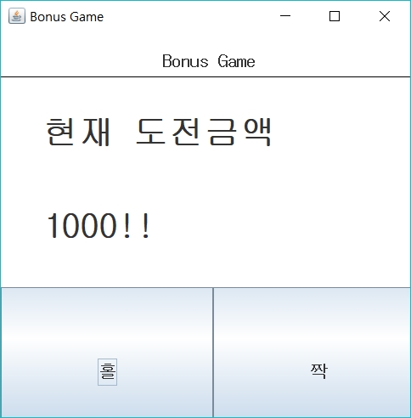
Detailed Project Description (5 / 5)

Slide 9
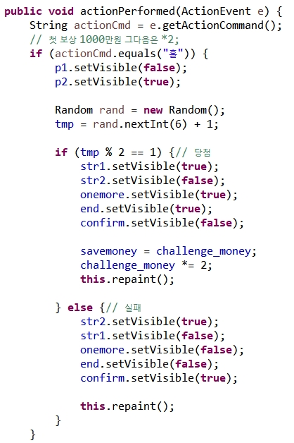
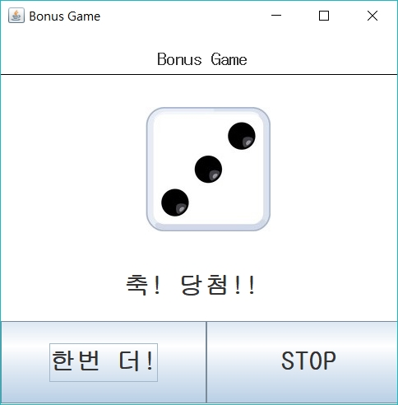
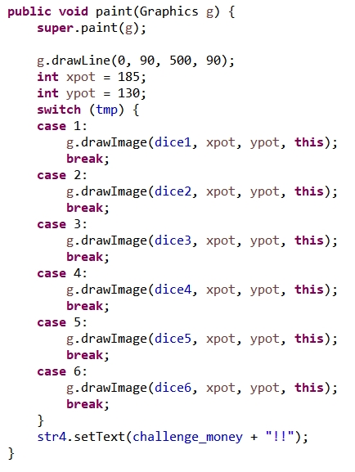
Detailed Project Description (5 / 5)

Slide 10
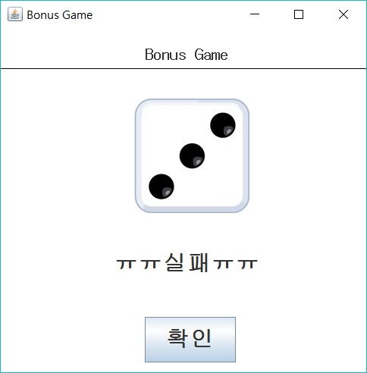
Detailed Project Description (5 / 5)

Slide 11
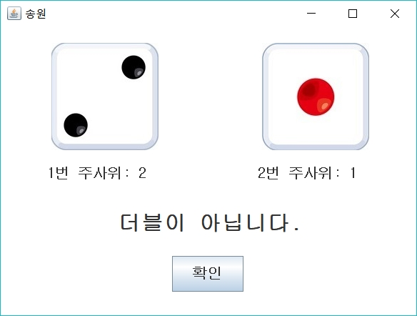
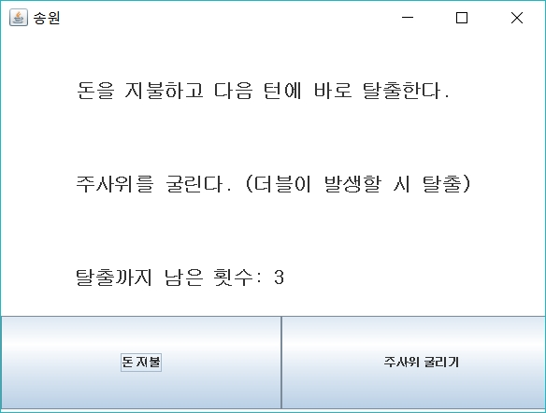
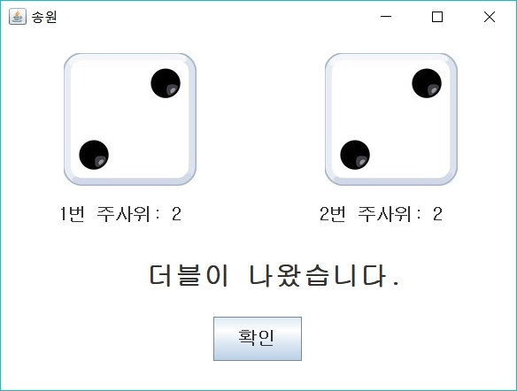
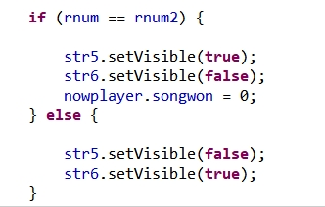
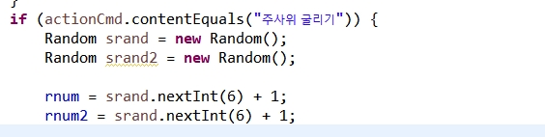
Detailed Project Description (5 / 5)

Slide 12
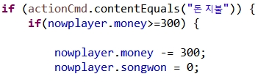
Detailed Project Description (5 / 5)

Slide 13
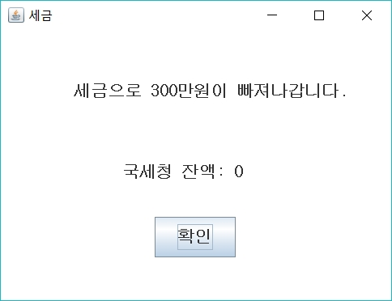
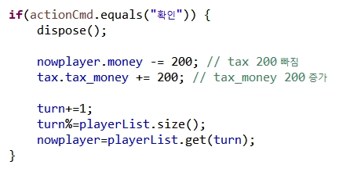
Detailed Project Description (5 / 5)

Slide 14
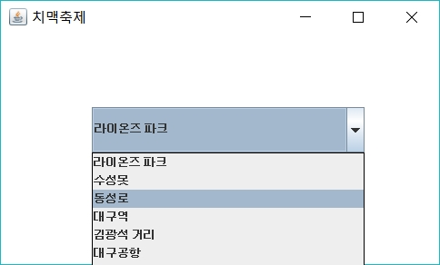
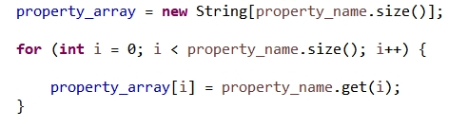
Detailed Project Description (5 / 5)

Slide 15
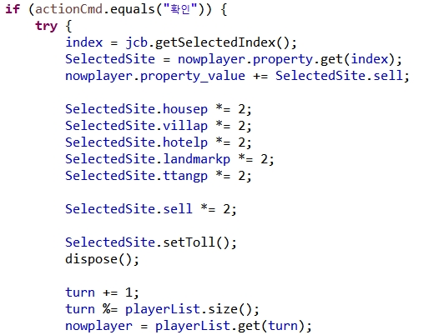
Detailed Project Description (5 / 5)

Slide 16
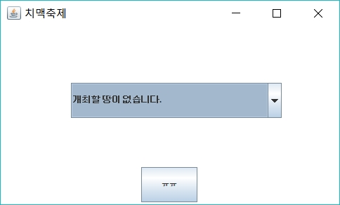
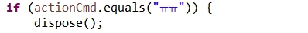
Detailed Project Description (5 / 5)

Slide 17
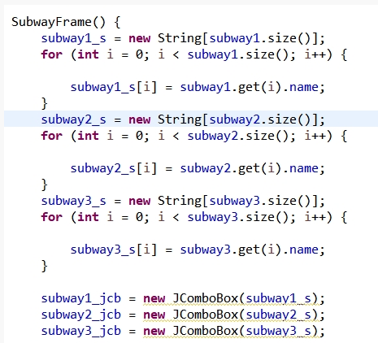
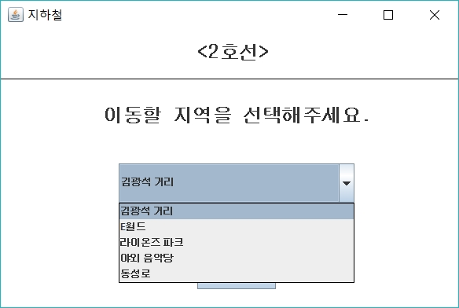
Detailed Project Description (5 / 5)

Slide 18
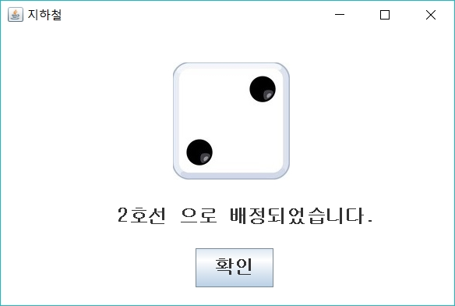
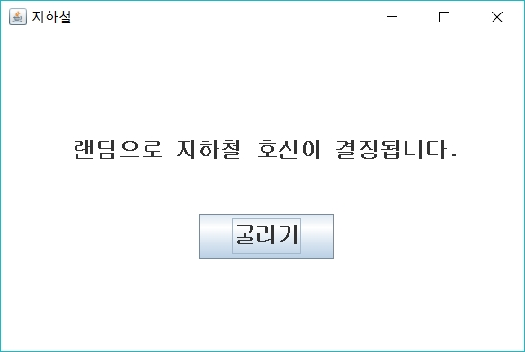
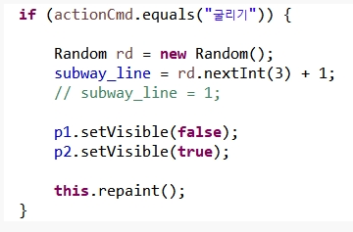
Detailed Project Description (5 / 5)

Slide 19
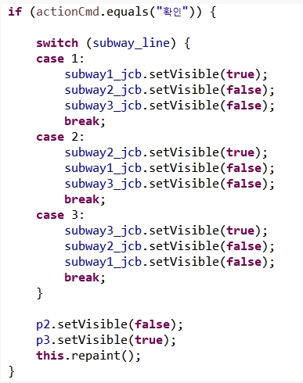
Detailed Project Description (5 / 5)

Slide 20
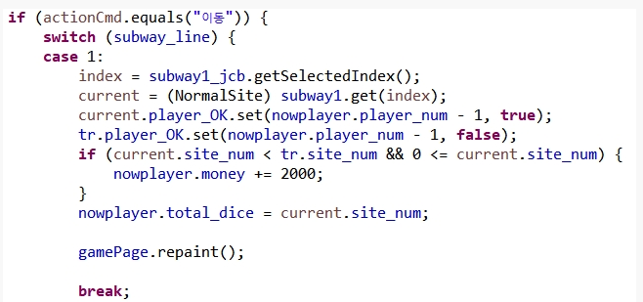
Detailed Project Description (5 / 5)

Slide 21

Detailed Project Description (5 / 5)
경북대학교 축제
E월드 별빛 축제
국세청 세금 받기
지하철 환승 티켓

Slide 22
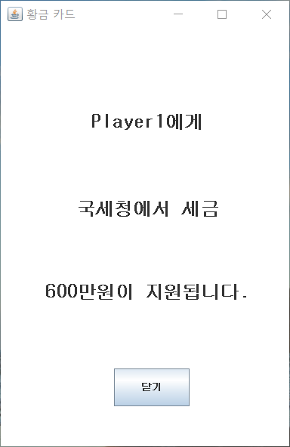
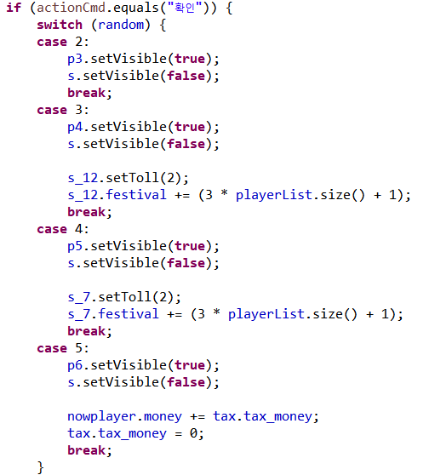

Detailed Project Description (5 / 5)

Slide 23
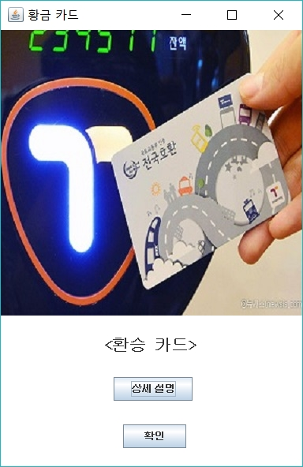
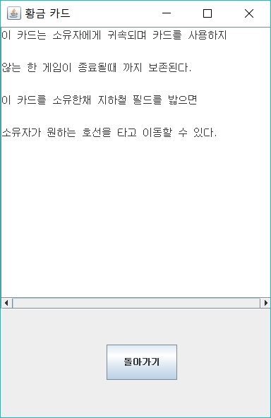
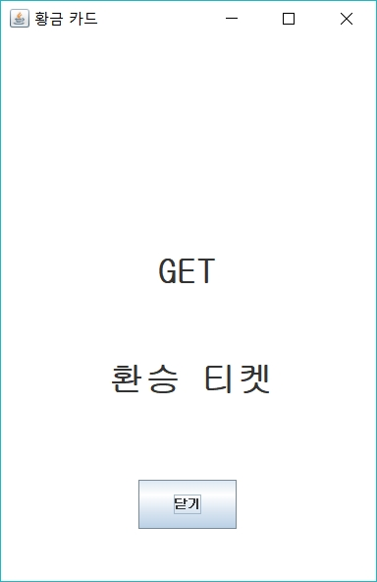
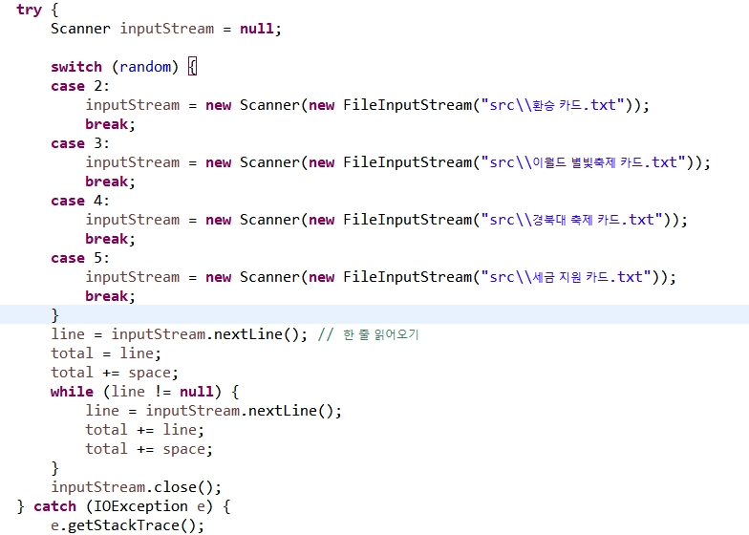
Detailed Project Description (5 / 5)
FILE I/O

Slide 24
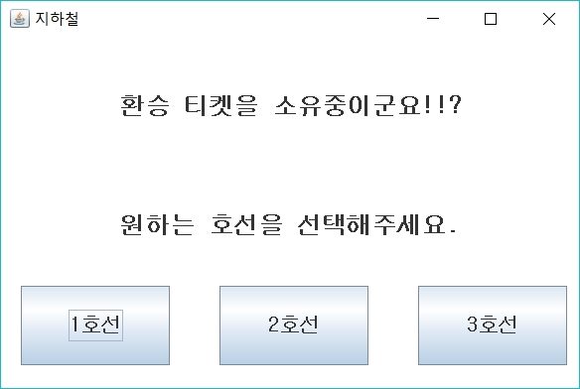
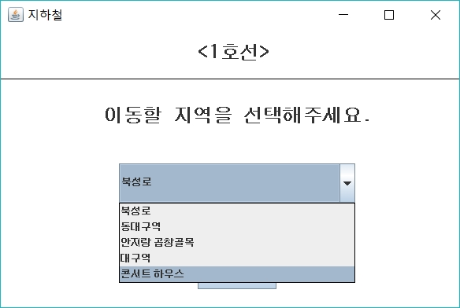
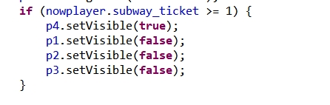
Detailed Project Description (5 / 5)

Slide 25
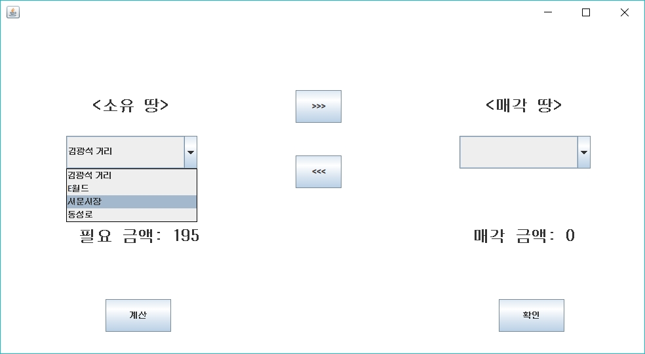
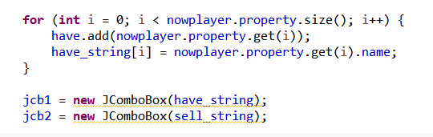
Detailed Project Description (5 / 5)

Slide 26
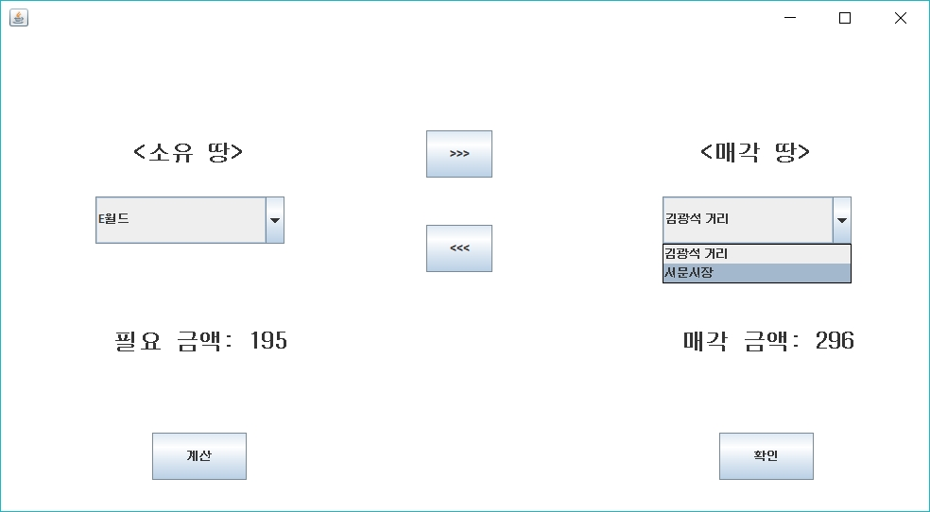
Detailed Project Description (5 / 5)

Slide 27
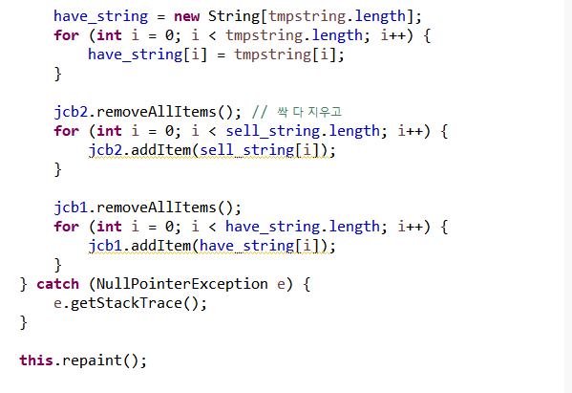

Detailed Project Description (5 / 5)

Slide 28
Detailed Project Description (5 / 5)

Slide 29


Detailed Project Description (5 / 5)

Slide 30


Detailed Project Description (5 / 5)

Slide 31



Detailed Project Description (5 / 5)

Slide 32



Detailed Project Description (5 / 5)

Slide 33


Detailed Project Description (5 / 5)

Slide 34


Detailed Project Description (5 / 5)

Slide 35


Detailed Project Description (5 / 5)

Slide 36
Detailed Project Description (5 / 5)

Slide 37
Summary of Project Code
Total Line of Code: 3794
Whether to reflect the required technologies in your project:
Class: O
Inheritance: O
File I/O: O
Collect (which collection?): O
GUI: O
README file: O / X
Describe in your README how to run your code, what environments to be configured, and so forth, for testing your code.

Slide 38
Demo
Now show your demo.

Slide 39
Q & A

